Slide 1
Notes:
Active Learning
The motivation behind active learning is:
Annotating data is expensive.
Labeling all samples is expensive and leads to redundant labels. Labeling randomly also leads to redundant samples. By labeling actively the aim is to reduce the number of redundant samples by querying samples that maximize information gain w.r.t. model parameters.
At the same time Modern deep neural networks are data hungry.
Sample data points that maximize information gain w.r.t. model parameters.
Guide the sampling process during parameter optimization, to learn faster. The data sampling is considered active
Reduce cost of training ML models.
The advantage of AL is that it often results in dramatic reductions in the amount of labeling required to train an ML system (and therefore cost and time).
Bayesian Active Learning
Consider the uncertainty w.r.t. the model parameters.

Slide 2
Active Bayesian Deep Learning
Oral Exam – Mads Birch Sørensen (s195552)

Slide 3
Motivation
Active Learning
Annotating data is expensive.
Modern deep neural networks are data hungry.
Sample datapoints that maximize information gain w.r.t. model parameters.
Reduce cost of training ML models.
Bayesian Active Learning
Consider the uncertainty w.r.t. the model parameters.
Notes:
Active Learning
The motivation behind active learning is:
Annotating data is expensive.
Labeling all samples is expensive and leads to redundant labels. Labeling randomly also leads to redundant samples. By labeling actively the aim is to reduce the number of redundant samples by querying samples that maximize information gain w.r.t. model parameters.
At the same time Modern deep neural networks are data hungry.
Sample data points that maximize information gain w.r.t. model parameters.
Guide the sampling process during parameter optimization, to learn faster. The data sampling is considered active
Reduce cost of training ML models.
The advantage of AL is that it often results in dramatic reductions in the amount of labeling required to train an ML system (and therefore cost and time).
Bayesian Active Learning
Consider the uncertainty w.r.t. the model parameters.

Slide 4
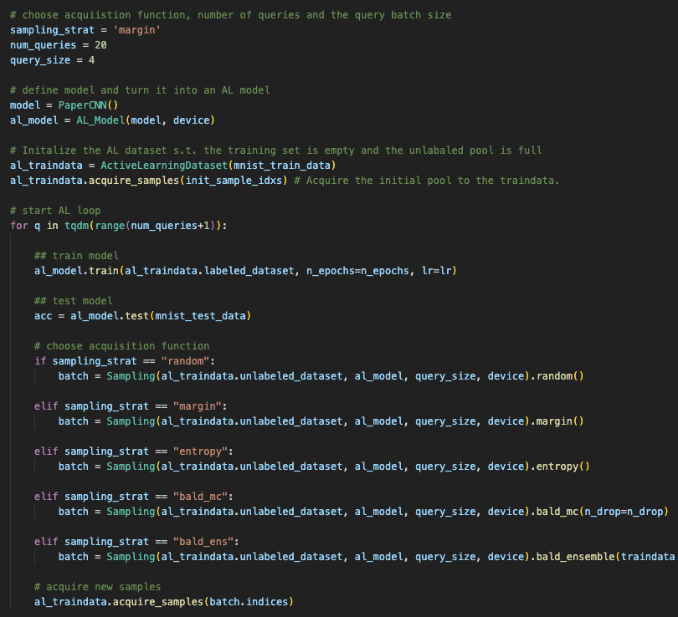
Active Learning Framework
Active Learning Steps:
Train the model on the initial data pool.
Score all data points based on an acquisition function.
Query the batch of samples which maximises the acquisition function.
The acquired samples are labelled and added to the training data.
Re-train the model on the new data pool.
Repeat from step 2.
Notes:
The active learning framework consists of the following steps and can be implemented by implementing an active learning dataset class in pytorch.
Steps
A model is trained on a small amount of data (the initial training set),
and an acquisition function is used to select data points to ask an external oracle for a label.
The acquisition function selects one or more points from a pool of unlabelled data points, with the pool points lying outside of the training set.
An oracle (often a human expert) labels the selected data points, these are added to the training set,
and a new model is trained on the updated training set. This process is then repeated, with the training set increasing in size over time.

Slide 5
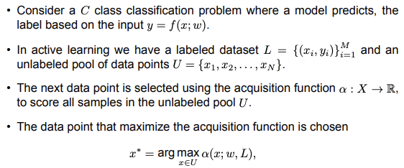
Problem Formulation
Notes:
5. Problem Formulation
If we consider a classification problem.
We have a labeled and unlabeled pool of data.
We select data points to add to the training pool by scoring all samples in the unlabeled pool using an acquisition function.
The point that maximize the acquisition function is chosen.

Slide 6
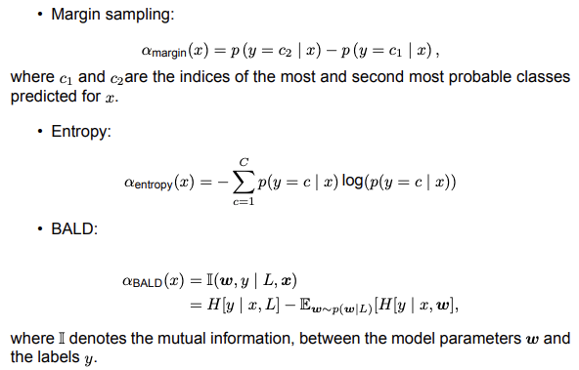
Acquisition Functions
Notes:
6. Acquisition Functions
Margin
Selects samples where the decision margin (difference between the first most probable and second most probable predicted labels) is smallest.
Entropy
Entropy is maximized when the predictive distribution is uniform, ie. where the model is least confident in a single class.
BALD
BALD is based on the mutual information.
BALD selects samples to annotate by maximizing the mutual information between the model parameters and the labels.
BALD use the mutual information (MI). Thus, we can interpret the MI between w and y as the reduction in uncertainty about w after observing y. We choose the points that reduce the uncertainty the most.

Slide 7
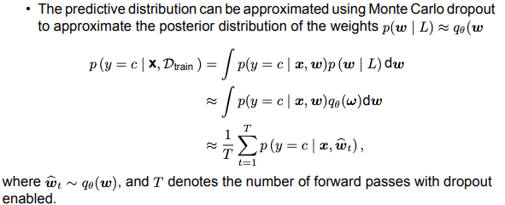
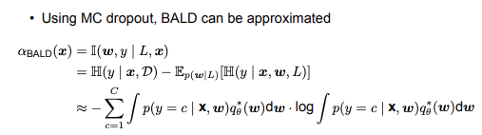
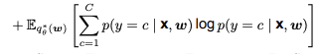
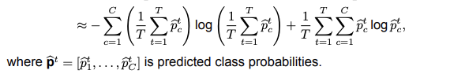
Bayesian Active Learning
)
Notes:
7. Bayesian Active Learning
The predictive distribution can be approximated using Monte Carlo Dropout.
The BALD acquisition function we can then plug in the predictive distribution.
First line is the mutual information.
I[y, w] is the mutual information between the labels and the model parameters. We want to maximise this in order to learn as efficiently as possible.
Second line. This is given as the predictive entropy minus the expected entropy.
Third line. We can use the sum rule to expand the predictive distribution and make the marginalization over w explicit.
The predictive distribution is approximated using T MC dropout samples.
First term is the predictive entropy of the average model
The second term is the expected entropy
Bayesian Active Learning by disagreement:
First term:
The first term selects samples with high predictive uncertainty. Similar to the other acquisition functions.
However, this will also select samples that are inherently noisy, and thereby do not contain information relavant to the model parameters
The first term looks for images that have high entropy in the average output.
The first term prefers examples x for which there is uncertainty in the predicted label. Just using this as a selection criterion is equivalent to uncertainty sampling, which we discussed above.
However, this can have problems with examples which are inherently ambiguous or mislabeled.
Second term:
The second term penalizes images where many of the sampled models are not confident about. This keeps only images where the models disagree on.
The second term penalize samples where many of the models are not confident.
Removes samples that are confusing or ambiguous.
Hence, BALD sample cases where the models disagree. If we sample many networks using MC Dropout, and they disagree about the output, this means that some of them are wrong.
This has the effect of ignoring the aleatoric uncertainty and focusing on epistemic uncertainty.

Slide 8
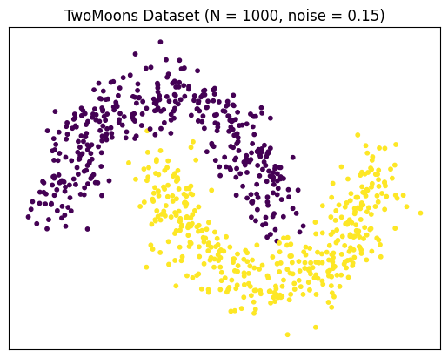
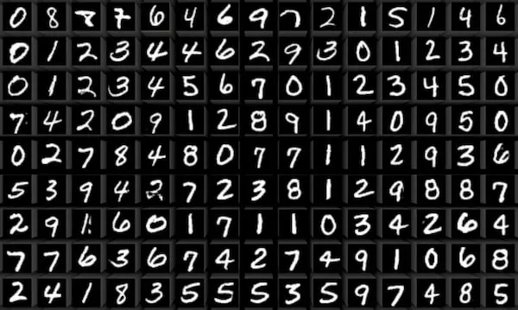
Experimental Setup
Datasets:
TwoMoons
MNIST
Models:
Bayesian FNN
Bayesian CNN (Deep Bayesian Active Learning with Image Data, Gal et al. 2017)
Approximation Methods:
Monte Carlo Dropout
Ensembles
Notes:
First we will look at a 2D dataset, the TwoMoons dataset so we can investigate the sampling behavior of the different acquiistion functions and understand the differences better.
We will then try to replicate the paper ”Deep Bayesian ….”

Slide 9
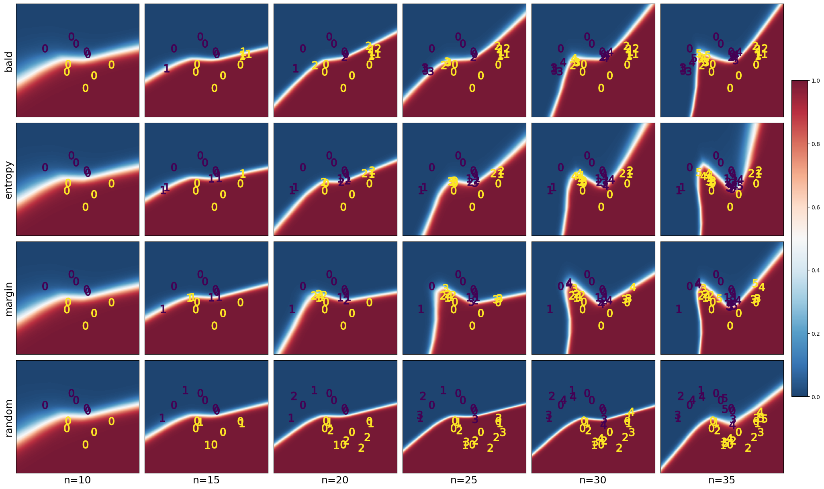
TwoMoons – Decision Boundaries
Notes:
9. TwoMoons Decision Boundaries
Margin sampling selects instances where the decision margin (difference between the first most probable and second most probable predicted labels) is smallest. In the context of the TwoMoons dataset, margin sampling is likely to focus on instances near the decision boundary between the two moons. This is because instances near the boundary are those where the model is most uncertain between the two classes, resulting in smaller margins.
Entropy samples where the entropy is highest, which is highest when the predictive distribution is uniform. This is most likely to happen along the decision boundary.
BALD is also more likely to sample along the decision boundary (frist term), but due to the second term, samples that the model agree are confusing are given a large negative weight.
This could be outliers.
Inherently noisy points.

Slide 10
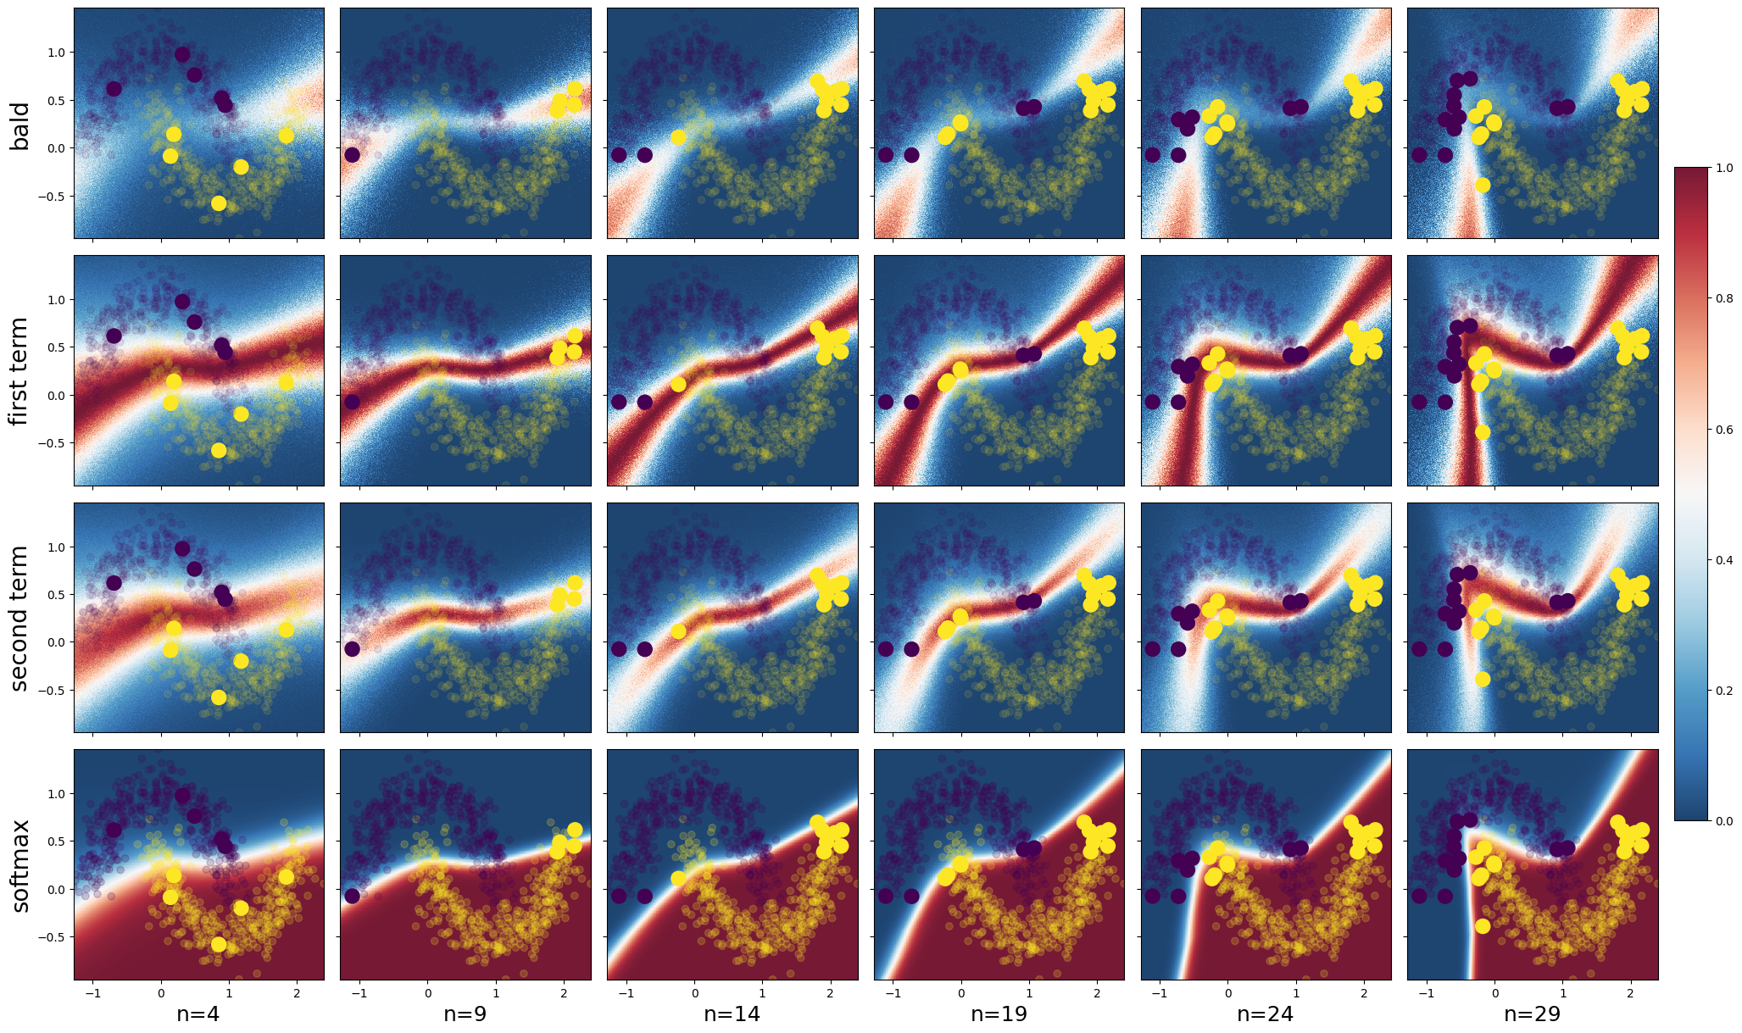
Understanding BALD
The first term selects samples with high predictive uncertainty.
The second term down-weigh samples that are inherently ambiguous.
Aleatoric vs epistemic uncertainty.
Limitation:
Samples with high expected entropy was not investigated.
Notes:
10. Understanding BALD
From the BALD definition we see that in order to have high mutual information we need to have high uncertainty (high entropy) about the predictions after marginalising over all models BUT each each model is confident (low expected entropy).
From the BALD eq.
•we see that in order to have high mutual information we need to have high uncertainty (high entropy) about the predictions after marginalising over all models BUT each each model is confident (low expected entropy).
The first term selects samples with high predictive uncertainty. Similar to the other acquisition functions. However, this will also select samples that are inherently noisy, and thereby do not contain information relavant to the model parameters
The first term looks for images that have high entropy in the average output.
It’s the entropy of the average output,
The second term penalizes images where many of the sampled models are not confident about. This keeps only images where the models disagree on.
The second term penalize samples where many of the models are not confident.
Removes samples that are confusing or ambiguous.
It is the expected entropy, so it is maximized when the entropy of each model is highest, which is when the preditive dist is uniform.
Hence, BALD sample cases where the models disagree. If we sample many networks using MC Dropout, and they disagree about the output, this means that some of them are wrong.
This has the effect of ignoring the aleatoric uncertainty and focusing on epistemic uncertainty.

Slide 11
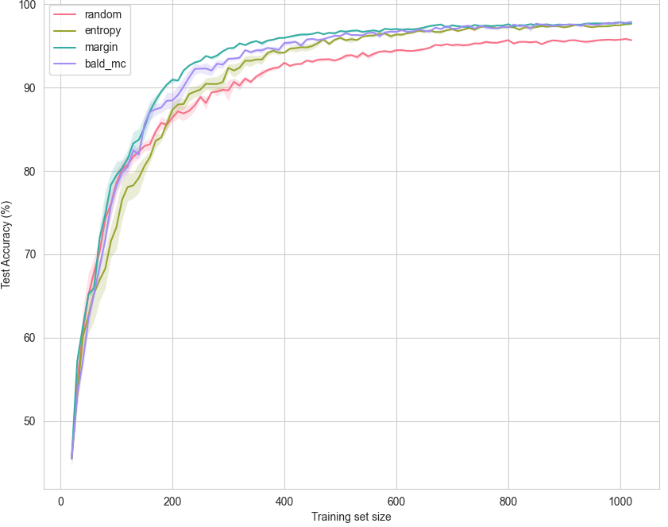
MNIST – Learning Curves
Setup:
Monte Carlo Dropout (T=10)
Query batch size of 100.
Findings:
AL learn faster and plateau at a higher accuracy.
Notes:
The intention was to replicate the paper Deep Bayesian Active Learning With Image Data.
Setup:
- MC dropout T = 10
Results:
It was replicated. The Active Learning strategies learn faster and plateau at a higher accuracy.
11. MNIST - Learning Curves
We wanted to investigate whether AL is preferred in a classification task. MNIST.
It was found that active learning leads to faster learning and plateauing at a higher accuracy.

Slide 12
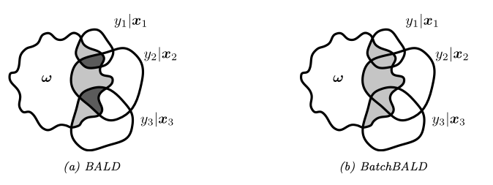
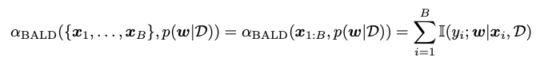
Batch Aware Methods – BatchBALD
Motivation:
Deep Neural Networks are computationally expensive to train.
Ensuring batch diversity to maximize information gain.
BALD vs BatchBALD:
xx
xx
Figure from Kirsch et al. 2019
Notes:
Batch aware methods are necessary as Deep Neural Networks are expensive to train, meaning that adding only one data point to the training set does not justify re-training of the model considering the small amount of additional information gained from a single data point.
Non batch aware acquisition functions can be and are used to query multiple data points, however this is not optimal, since the highest ranking data points are often similar. Batch aware methods such as BatchBALD takes this correlation between the data points in the query set, maximising the diversity of the queried samples.
SAY this:
BALD for multiple samples sums up the mutual information for each sample, which means that the overlaps are doulbe counted.
BatchBALD conisders the joint mutual iniormation.
12. Batch aware methods
However, training a deep neural network is computationally expensive, and batch aware acquisition functions are therefore needed.
The key challenge is to ensure that the batch of samples is diverse, so we maximize information gain.
Equations:
The naive extension of BALD would sum the individual mutual information scores for each data point in the batch.
However, this can lead to samples that are very similar (redudancy)
Figure
BALD as a sum of individual intersections, where the overlaps are double counted.
BatchBALD, on the other hand, considers the joint mutual information.
Instead of summing the mutual information of individual data points with the model parameters, BatchBALD computes the mutual information between the set of all labels in the batch and the model parameters.
This means that BatchBALD takes into account the information gained about the parameters from the entire batch combined, rather than considering each point's contribution independently.
Reduces redundancy in the batch.
In other words:
Considers the correlation between the samples in the batch.
Figure
BALD as a sum of individual intersections, where the overlaps are double counted.
BatchBALD takes the overlap between samples into account.
Does not double count the overlaps in the figure.
The first term is the joint entropy and is difficult to compute.
Computed by:
Difficult since all combinations of batches has to be evaluated, which increase exponentially as a function of the batch size.
BatchBALD is computed using a greedy approach.
For each 1,..b samples in the batch, the datapoint that maximizes the joint mutual information is added.
All possible combinations of batches has to be improved to calculate the exact BatchBALD, but the number of combinations increase exponentially as the batch size increase.
Therefore BatchBALD typically employs a greedy approach to select data points one at a time, each time choosing the point that, when added to the batch, maximizes the joint mutual information. This approximation helps manage computational costs while still aiming to select a diverse and informative batch of data points.
I did not implement this myself.

Slide 13
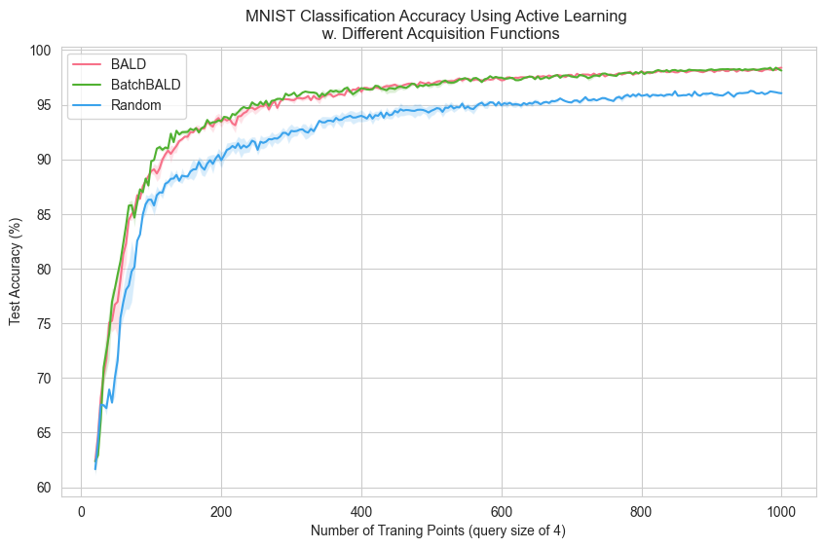
MNIST Dataset – BALD vs BatchBALD
Notes:
Query size was set to 4, since calculating BatchBALD requires a lot of memory.
No difference between BALD and BatchBALD was found, but the batch size was small, 4.
A larger batch size would likely change the results, but increasing the batch size increases the memory footprint.

Slide 14
What was found?
Active Learning leads to faster learning and higher accuracy.
The desired sampling behavior was confirmed in 2D.
BALD did not lead to faster learning than margin or entropy sampling, but came at a computional cost.
BatchBALD was not preffered over BALD for a batch size of 4.

Slide 15
Thank you for listening!

